Slide 1
Module 1: Lesson 2 – Fertilizer Recommendations
Notes:
In the previous lesson, we learned the different methods of soil sampling a field. In this lesson, we will discuss how to interpret our soil sample results to create a recommendation for fertilizer applications

Slide 2
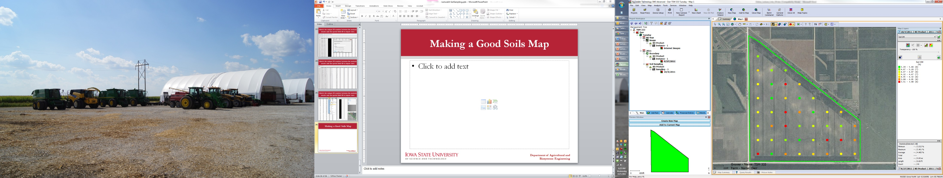
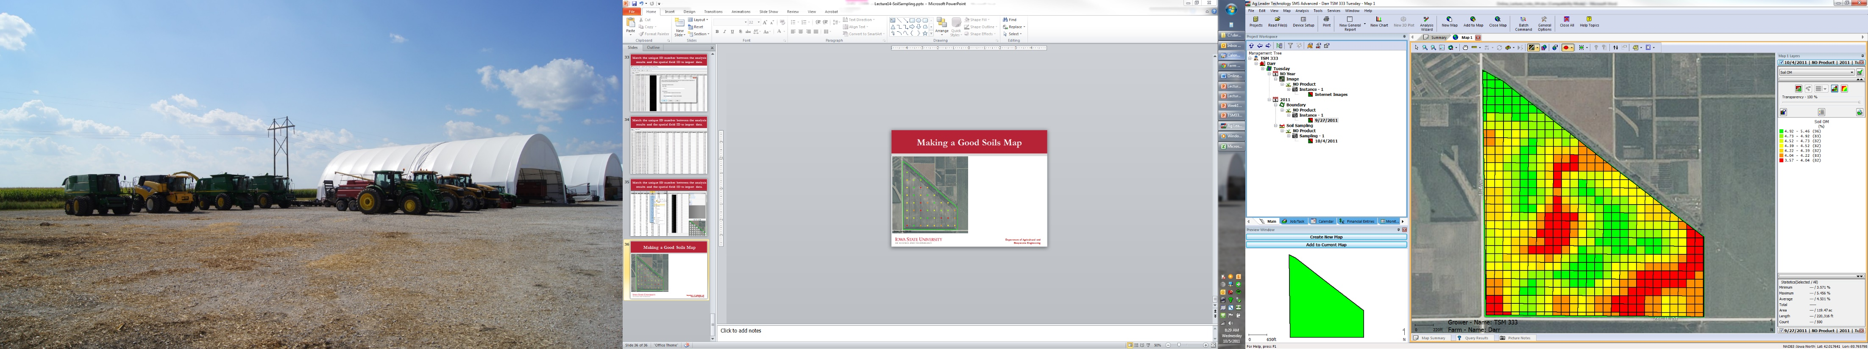
Making Soil Maps
Notes:
Soil fertility varies across a field, and to manage it effectively, we rely on soil sampling to collect data. However, soil sampling data is relatively sparse—typically, there are 300 to 400 feet between individual soil samples. This means we only have specific points of information rather than a full picture of the entire field’s fertility levels.
In the image on the left, you can see the raw soil sampling points, each representing actual fertility values from the field. While this data is useful, it’s difficult to make clear recommendations based solely on scattered points. To make better decisions, we need to estimate the fertility levels between these points and create a continuous map like the one on the right.
This process is called data interpolation—a method used to fill in the gaps between known data points. While interpolation can be complex, specialized software programs automatically handle this for us. By using these tools, we can generate gridded fertility maps that visually represent variations across the field.

Slide 3
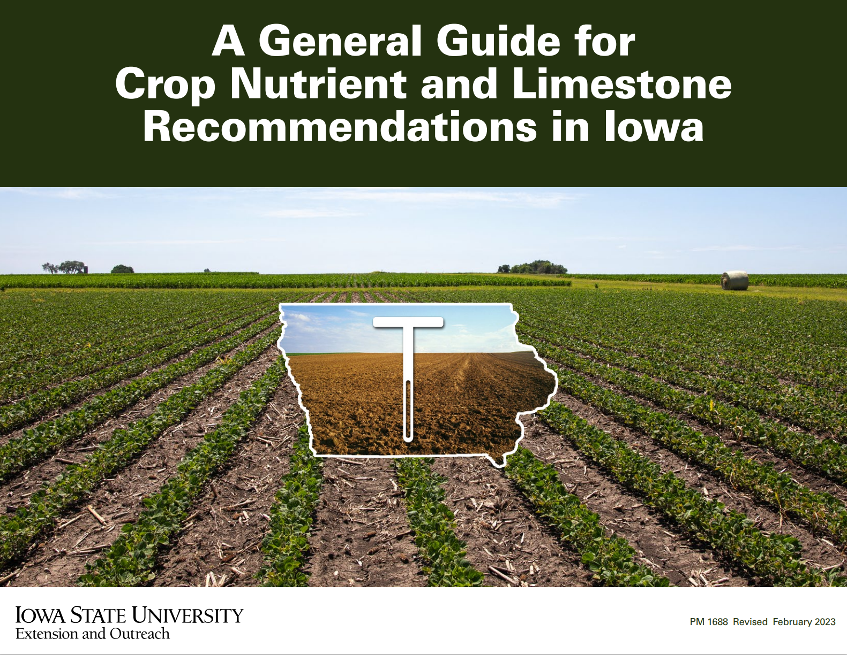
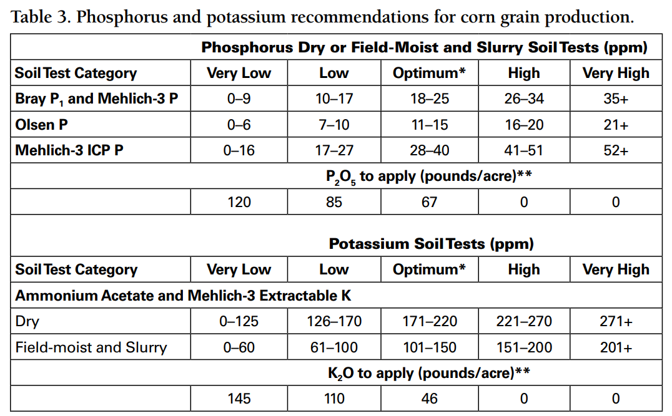
Application Recommendations
Notes:
Recommendations (how we convert a soil fertility level into a required amount of ag fertilizer applied) is very regionally specific. This knowledge is generated through years of scientific research mostly done at a university or non-profit. These help producers understand their crop yield potential.
Fertilizer application rates are a delicate balance. If we don’t apply enough fertilizer then we save money on inputs but we could be limiting the yield potential of our field. If we apply too much of a specific fertilizer, it won't hurt the crop but it also won’t help the crop and we will have wasted money on fertilizer that we did not really need. As a producer, we are usually trying to maintain and balance our fertility cost to meet the needs of a crop. We do not want to exceed those needs by very much otherwise we will have the potential to spend more on fertilizer and not receive any return in the yield potential of that crop. We have a guideline in Iowa called the “A general guide for crop nutrition and limestone recommendations in Iowa.”. This is an extension bulletin that goes by PM 1688. This is updated every few years as new information is available.
When we take a soil sample we are going to get a parts per million level (ppm level) back for that specific soil sample. What is critical to know is that the level of the ppm value and how we interpret it is depended on the type of test that was used to test that soil sample. There are multiple types of tests that we can use to extract and evaluate the level of a fertilizer in the soil. We have the know what kind of test we used so we can interpret the results.

Slide 4
Application Recommendations
Notes:
When you see “Bray P1 and Mehlich-3 P”, “Olsen P”, or “Mehlich-3 ICP P” those are three different types of soil test categories all of which will produce an estimate for phosphorus levels in the soil but the numeric value of that will be different depending on the type of test that was conducted. Imagine that we take the exact same soil sample, split it in half, test half of it with a Bray P1 test and the other half of it with an Olsen P test. We will get phosphorus levels from both tests, but the numerical value of the phosphorus levels will be different.

Slide 5
Application Recommendations
Notes:
Once we know what test we are using, we can use the table that corresponds to our operation to determine where our soil fertility level falls within the categories (Very low, Low, Optimum, High, and Very High). We can then determine an estimate of how much fertilizer we need to apply based on our current soil fertility levels.

Slide 6
Application Recommendations – Example 1
Corn grain production
Mehlich-3 ICP P test
31 ppm phosphorus
Notes:
Now, lets walk through an example. Say that we work on a corn grain production operation and we just got a soil test result back that was from a Mehlich-3 ICP P test. The test results was 31 ppm.
The first thing that we need to do is find the table for corn grain production, this has been done for you (highlighted green above). We know that we are going to be in the Mehlich-3 ICP P test category (highlighted blue above) since we know that that is the kind of test we did. Since 31 is between 28 and 40, we know that we are in the optimum zone (highlighted red above). Our fertility level to apply would be 67 pounds per acre of P2O5 (phosphorus fertilizer).
We would recommend applying 67 pounds of P2O5 fertilizer per acre to continue to support corn grain production.

Slide 7
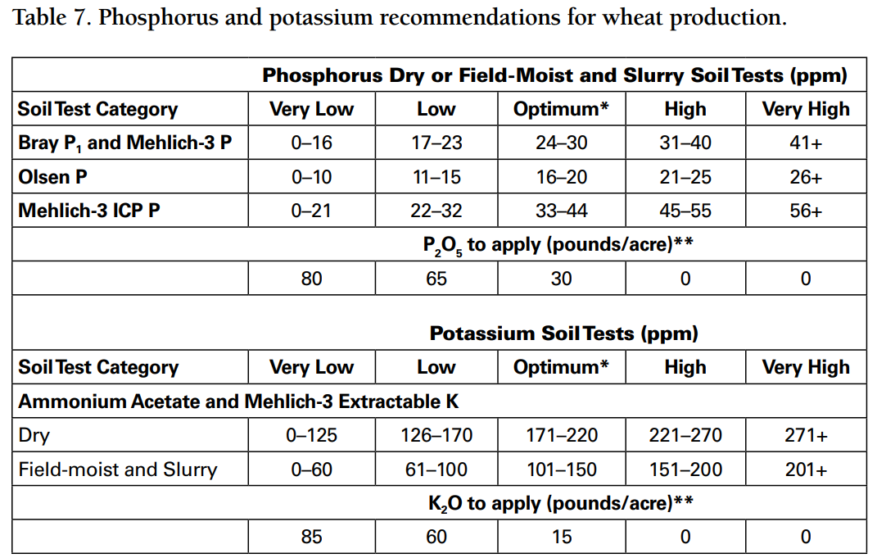
Application Recommendations – Example 2
Wheat production
Olsen P test
51 ppm phosphorus
Notes:
Now have students try it for themselves!

Slide 8
Application Recommendations – Example 2
Wheat production
Olsen P test
51 ppm phosphorus
Notes:
In this case, we would recommend adding no additional Phosphorus fertilizers. The current phosphorus levels in the field are sufficient to support the continued production of Wheat.

Slide 9
Application Recommendations – Example 3
Wheat production
Ammonium Acetate and Mehlich-3 extractable K test
Dry
138 ppm Potassium
Notes:
Here is another example. The trick behind this one is that we are switching from Phosphorus to Potassium. This guide only handles one type of Potassium test but it has “dry” and “field-moist and slurry” options.

Slide 10
Application Recommendations – Example 3
Wheat production
Ammonium Acetate and Mehlich-3 extractable K test
Dry
138 ppm Potassium
Notes:
We would recommend applying 60 pounds of K2O per acre to continue to support wheat production.
That’s all good but how do we do that? The next part of this lesson will take us through how we convert these recommendations levels into common commercial ag products

Slide 11
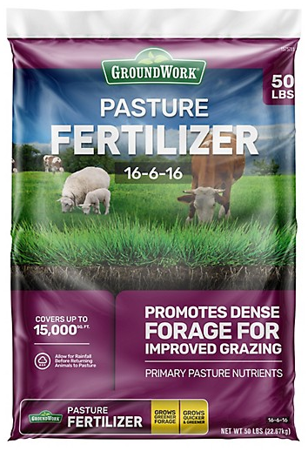
Units of Fertilizer
Fertilizer is sold in N-P-K form. The value for each indicates the percentage of the nutrient per unit of fertilizer
N: Elemental Nitrogen
P: P₂O₅ formulation
K: K₂O formulation
Common Agricultural Products
Ammonia: 82-0-0
Urea: 46-0-0
DAP: 18-46-00
Map: 11-52-00
Potash: varies but usually 0-0-60 or 0-0-50
Notes:
Its is great to know how many pounds of P2O5 or K2O we need to apply to our field but the problem is that ag retailers don’t sell pure P2O5 or K2O. They sell fertilizer products that could contain a range of concentrations of P2O5 and K2O. When we buy commercial fertilizer, we are not buying a pound of phosphorus or a pound of potassium, we are buying some blended mixture of the two.
Fertilizer is sold in N-P-K form. The value for each indicates the percentage of the nutrient per unit of fertilizer
The image on the right, shows N-P-K values of 16-6-16. That means that for every 100 pounds of this fertilizer that we apply, we are actually applying 16 pounds of elemental nitrogen, 6 pounds of P2O5 and 16 pounds of K2O. We very likely would need to buy a different amount of fertilizer if we used a different product but wanted to apply the same amount of P2O5 or K2O
Once we know how many pounds of phosphorus or potassium that we need and we know what product we want to use, we have to do some math to figure out how many pound of our chosen product we need to purchase to apply.
Ask students:
Q: if I apply 50 pounds of DAP, How many pounds of P2O5 and K2O am I applying?
A: 9 pounds of P2O5 and 0 pounds of K2O.

Slide 12
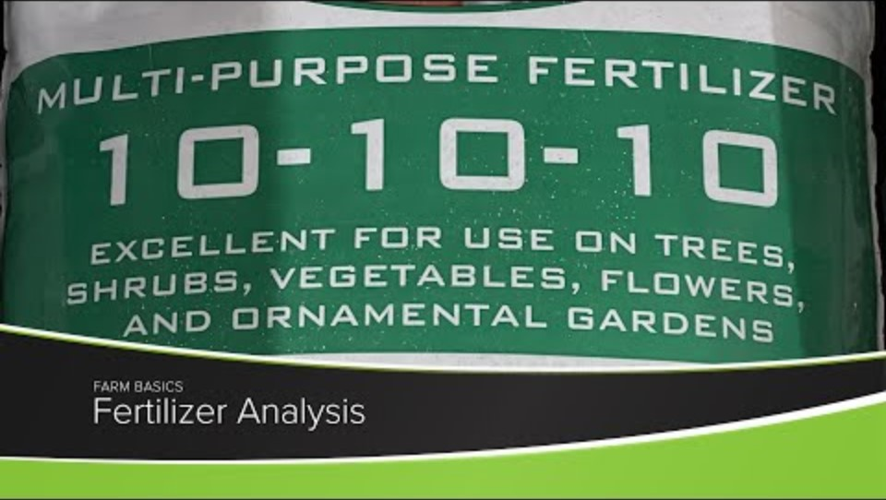
Notes:
This is a short video that does a very good job of explaining how to read fertilizer labels.

Slide 13
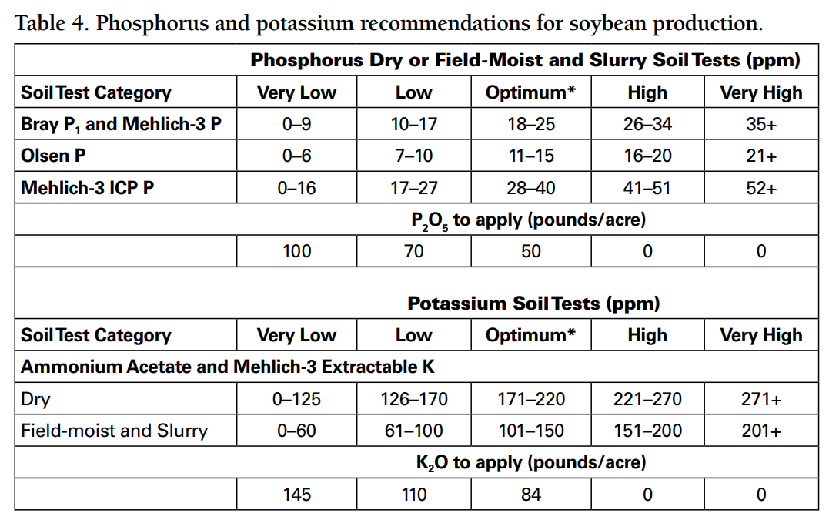
Application Recommendations – Example 4
Calculate the amount of MAP (11-52-00) per acre required for soybean production based on the following soil test values
Mehlich-3 P: 12 ppm
Notes:
This is a very good example of what farmers in Iowa actually do to determine fertilizer application rates.

Slide 14
Application Recommendations – Example 4
Calculate the amount of MAP (11-52-00) per acre required for soybean production based on the following soil test values
Mehlich-3 P: 12 ppm
$$\frac{70 lbs \text{P}\text{2}\text{O}\text{5}}{Acre} ×\frac{1 lb of MAP}{0.52 lbs \text{P}\text{2}\text{O}\text{5}}=145.65 lbs of MAP/Acre$$

Slide 15
Application Recommendations – Example 5
If 67 lbs/ac of phosphorus (P₂O₅) is required, then how much DAP (18-46-00) would you buy for an 80-acre field?
Notes:
This is a very good example of what farmers in Iowa actually do to determine fertilizer application rates.

Slide 16
Application Recommendations – Example 5
If 67 lbs/ac of phosphorus (P₂O₅) is required, then how much DAP (18-46-00) would you buy for an 80-acre field?
$$\frac{67 lbs \text{P}\text{2}\text{O}\text{5}}{Acre} ×\frac{1 pound of DAP}{0.46 lbs \text{P}\text{2}\text{O}\text{5}}=145.65 lbs of DAP per Acre$$
$$\frac{145.65 lbs of DAP}{Acre} ×80 Acres=11,652.17 lbs of DAP$$

